Slide 1
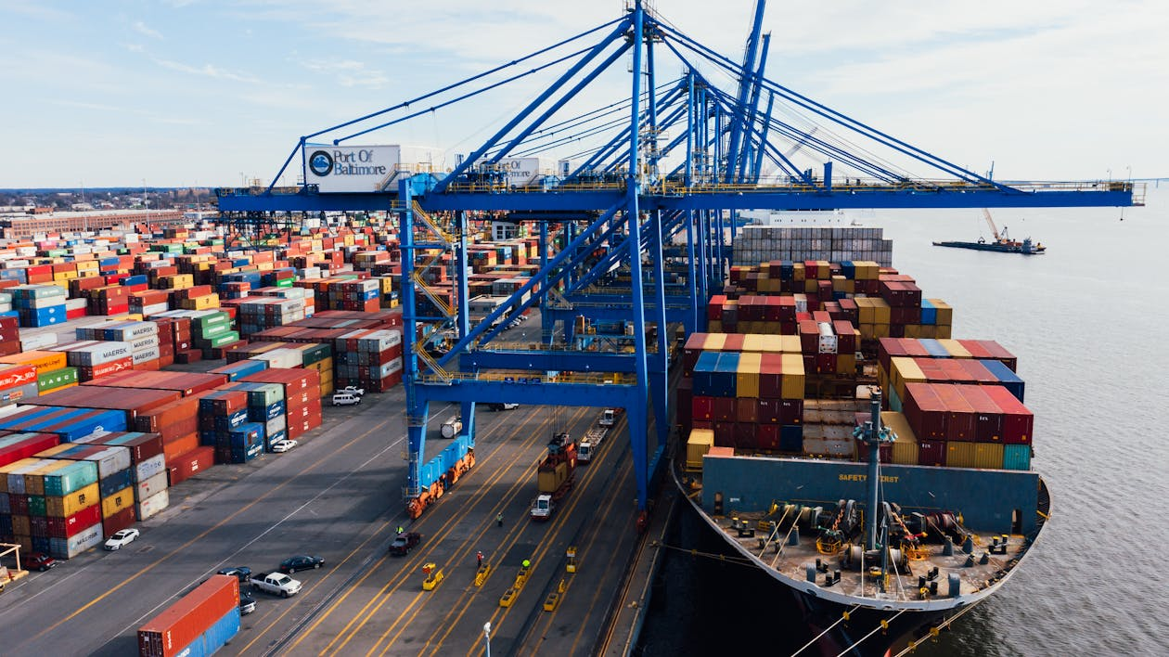
Sustainable Box Lifecycle Management

Slide 2
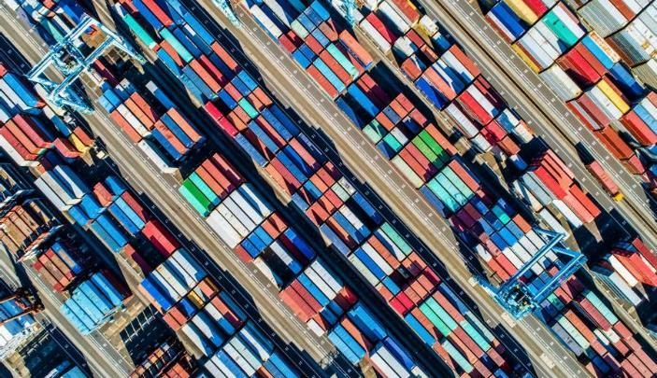
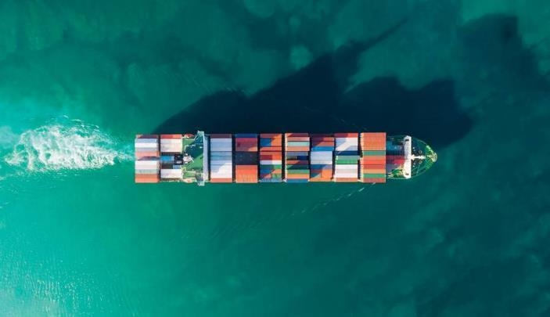
Sustainable Box Lifecycle Management
transforms packaging logistics by replacing single-use cardboard boxes with innovative, reusable plastic boxes.
Our solution minimizes waste, cuts shipping costs, and reduces environmental impact—driving efficiency and sustainability in high-volume operations.

Slide 3
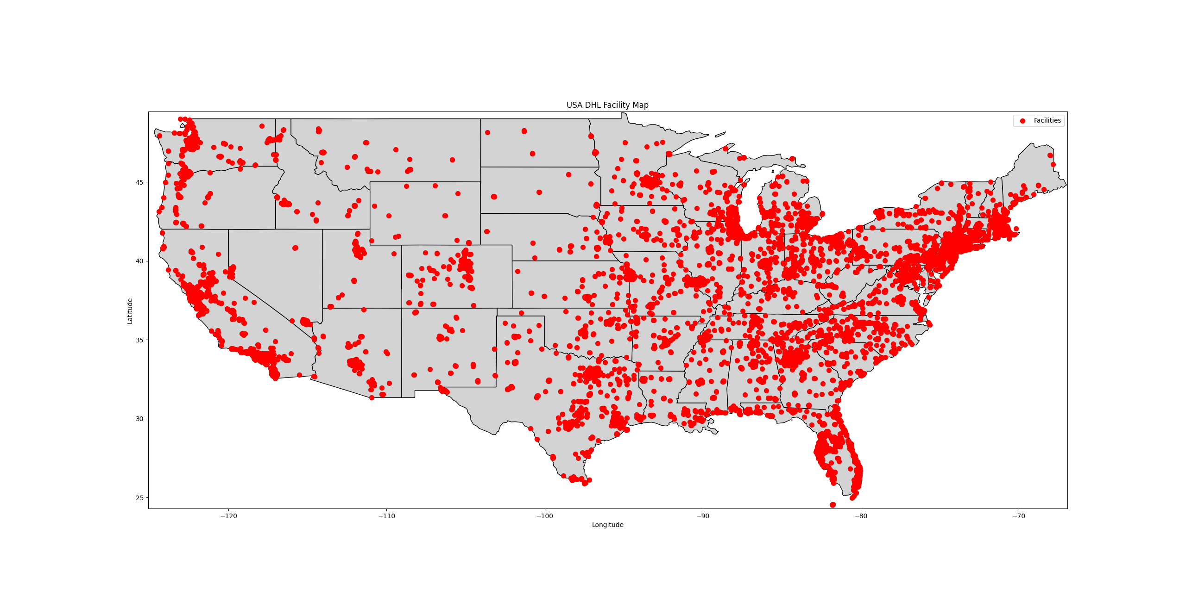
Map of DHL’s extensive USA network reveals the scale where single-use packaging creates significant waste and cost.
By replacing disposable boxes with reusable plastic ones, we unlock significant financial and environmental benefits.

Slide 4
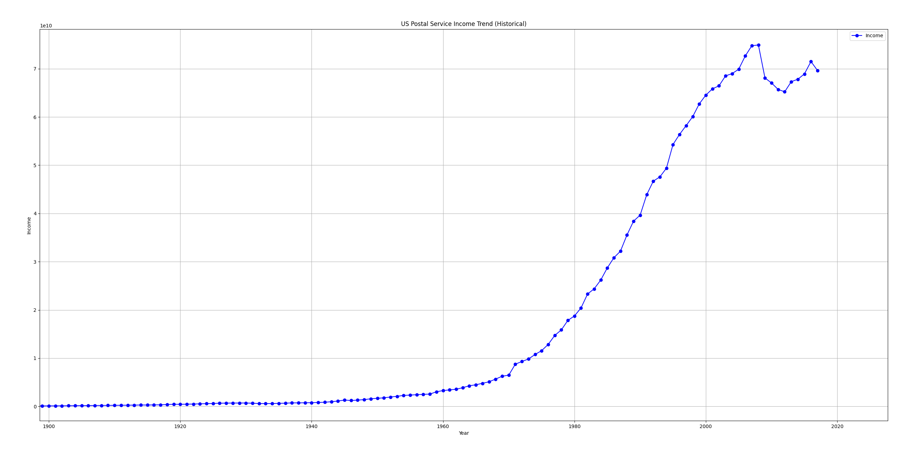
the USPS
Income trend

Slide 5
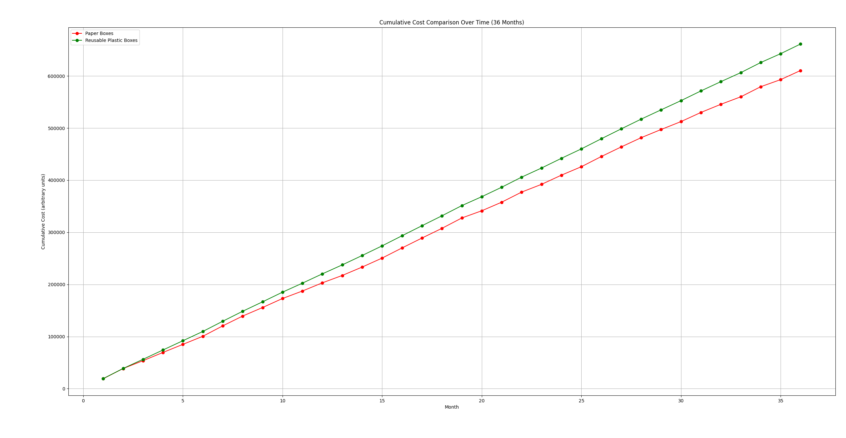
Comparison of traditional paper boxes—
costing 1.7 units per shipment

Slide 6
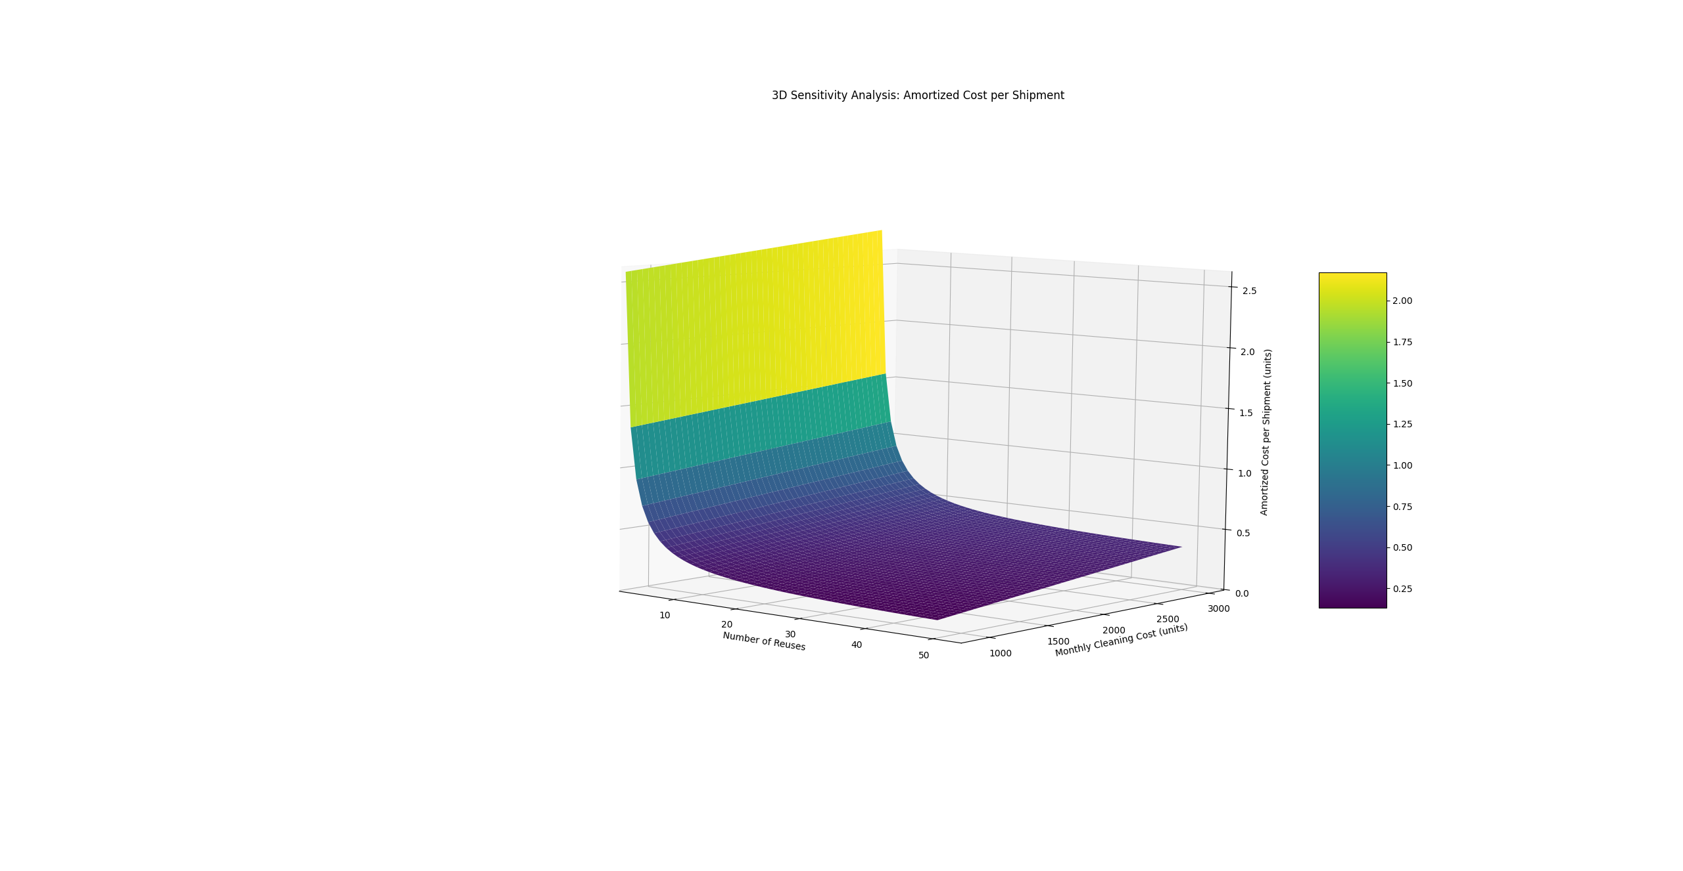
More reuse, less
cost.

Slide 7
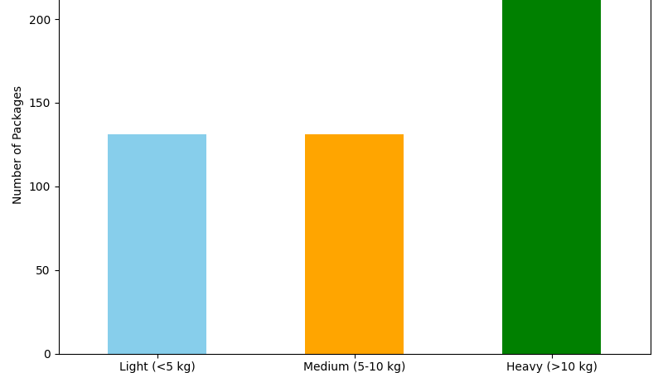
Right sized packaging

Slide 8
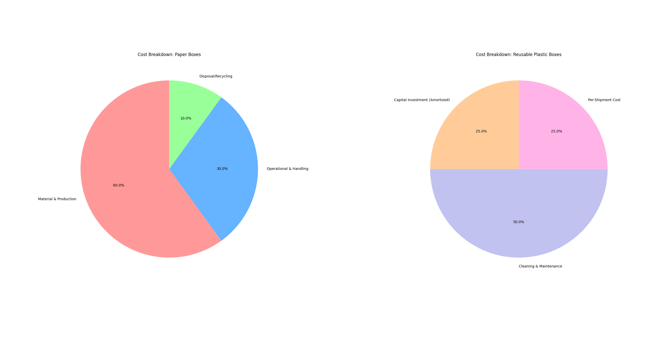
Cost breakdown refined

Slide 9
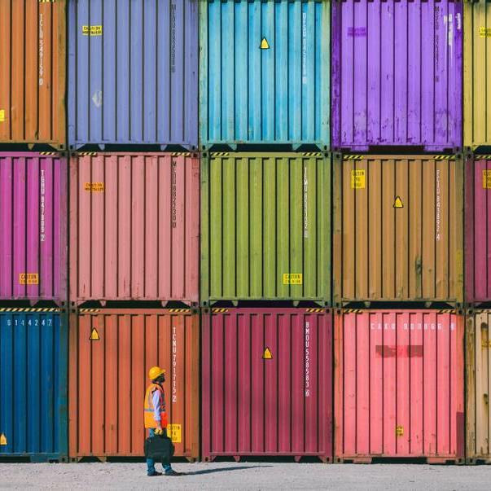
Summary
By integrating reusable packaging into the logistics chain, our system turns waste into a valuable asset. Using a data-driven approach to reverse logistics and design optimization, we achieve significant cost savings and environmental benefits, paving the way for a circular economy in the shipping industry.

Slide 10
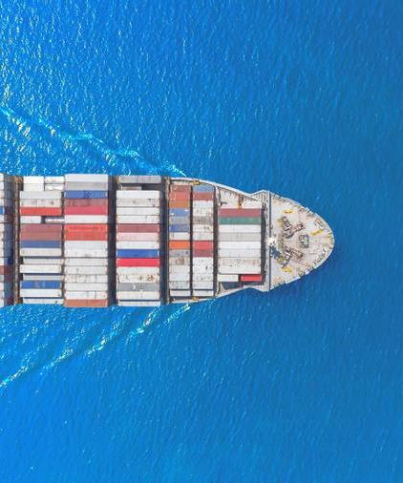
The business of business is to improve the state of the world.
Marc Benioff – Co-Founder, Chairman, CEO of Salesforce
2025

